Slide 1
Applications of Heap in Priority Queue Implementation
SR NO | Name | Roll No
1 | Parikshit Mitkar | 222044
2 | Priyanshu Nikam | 222045
3 | Atharva Patil | 222046
4 | Avadhut Patil | 222047
5 | Mayur Patil | 222048

Slide 2
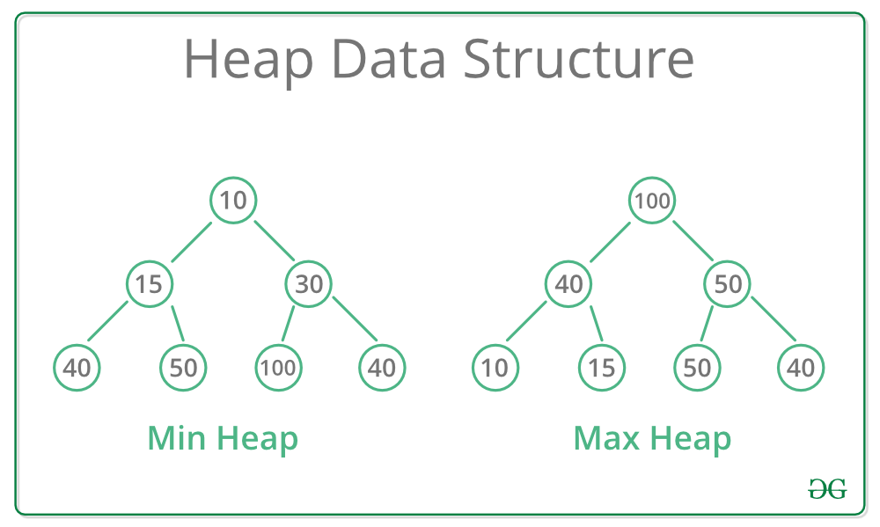
What is Heap?
A Heap is a special Tree-based data structure in which the tree is a complete binary tree. Generally, Heaps can be of two types:
Max-Heap: In a Max-Heap the key present at the root node must be greatest among the keys present at all of it’s children. The same property must be recursively true for all sub-trees in that Binary Tree.
Min-Heap: In a Min-Heap the key present at the root node must be minimum among the keys present at all of it’s children. The same property must be recursively true for all sub-trees in that Binary Tree.

Slide 3
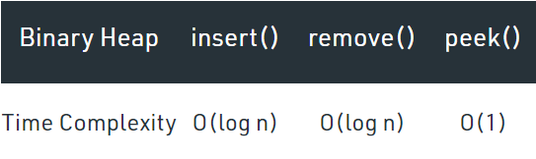
What is Priority Queue?
Priority Queue is similar to queue where we insert an element from the back and remove an element from front
But with a one difference the element with highest priority will be moved to the front of the queue and one with lowest priority will move to the back of the queue.
Time Complexity

Slide 4
Operation in Priority Queue
insert(p)/enqueue: Inserts a new element with priority p.
extractMax(): Extracts an element with maximum priority.
remove(i)/dequeue: Removes an element pointed by an iterator i.
changePriority(i, p): Changes the priority of an element pointed by i to p.

Slide 5
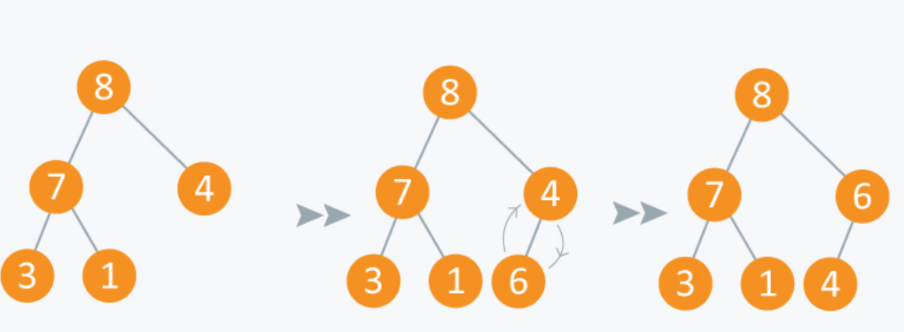
Insertion(Enqueue) in Priority Queue
8 | 7 | 4 | 3 | 1
8 | 7 | 4 | 3 | 1 | 6
8 | 7 | 6 | 3 | 1 | 4

Slide 6
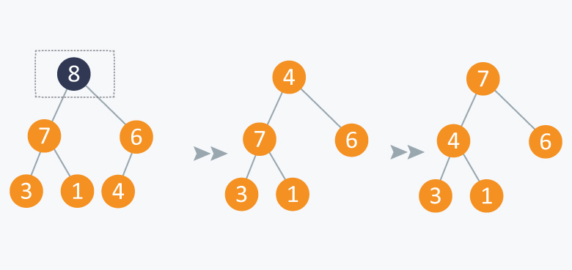
Deletion(Dequeue) in Priority Queue
8 | 7 | 6 | 3 | 1 | 4
4 | 7 | 6 | 3 | 1
7 | 4 | 6 | 3 | 1

Slide 7
Application of priority queue
Heap Sort: Heap sort is typically implemented using Heap which is an implementation of Priority Queue
In Operating Systems: In the load balancing algorithms, we use priority queues to maintain the flow of operations. Good load-balancing algorithms ensure a smoother flow and optimize the response time in various computations.
In Prim’s Algorithm: In the case of Prim’s Algorithm, we use a priority queue to store keys of nodes and extract minimum key nodes at every step.

Slide 8
Thanks!

